Slide 1

AGENTTRADE: A BULL-BEAR DEBATE DRIVEN MULTI-AGENT FRAMEWORK FOR STOCK ANALYSIS AND RISK-CONTROLLED PAPER TRADING
DEPARTMENT OF ARTIFICIAL INTELLIGENCE AND MACHINE LEARNING
Team Members
NISHA S (231501112)
DONEESWARAN J (231501502)

Slide 2

1
Problem Statement
Problem Definition
Business / Real-World Context
Stock Research-Helps users analyze market data, news, and supporting evidence.
Decision Support-Provides structured insights and multiple perspectives before trading decisions.
Paper Trading-Allows users to test trading decisions in a controlled simulation environment.
Financial Research-Can support students, researchers, and retail users in studying market trends.
Real-World Deployment-Requires stronger security, licensed financial data, operational controls, and expert/legal review.
Stock research mixes price trends, news, portfolio limits and uncertainty.
A chat model can answer confidently without showing evidence.
Risk of an accidental jump from analysis to execution.
Research, pending proposal and broker receipt are easily confused.
Data outages can be disguised as a "missing stock".

Slide 3
User and Stakeholder Analysis
2
Target Users
Stakeholder Identification
Stakeholder | Main Need
Retail Investor | Research stocks and evaluate recommendations
Financial Researcher | Analyze market data and supporting evidence
System Administrator | Manage models, data sources, and system configuration
Paper-Trading User | Review and approve paper-trading proposals
Retail Investors
Financial Researchers
Stock Market Analysts
Paper-Trading Users
Investment Students

Slide 4
Proposed System: Analysis Pipeline
3
Transforms a stock-research question into an evidence-based analysis and risk-controlled paper-trading proposal through a multi-agent workflow..
1
Research Query
2
Retrieval Agent
3
Analyst Agent
Accepts a stock-related question and identifies the required market information and evidence.
Searches relevant financial data and retrieves supporting information from the knowledge base.
Analyzes market data, trends, indicators, and retrieved evidence to generate a recommendation.
Bull + Bear Agent.
Risk Control + Approval
4
5
Critic+Correction
6
Provides opposing perspectives by identifying potential opportunities, risks, and weaknesses.
Applies deterministic risk limits and sends the proposal for human approval before paper-trading execution.
Critically evaluates the analysis and improves the response based on identified issues

Slide 5
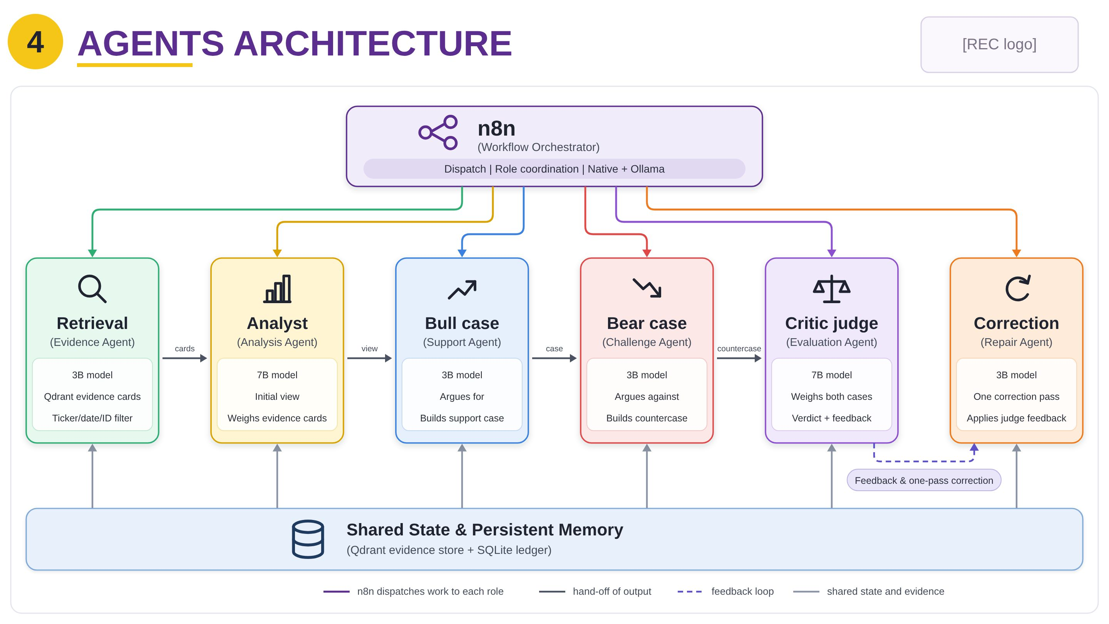
System Architecture: Tiered View
10

Slide 6
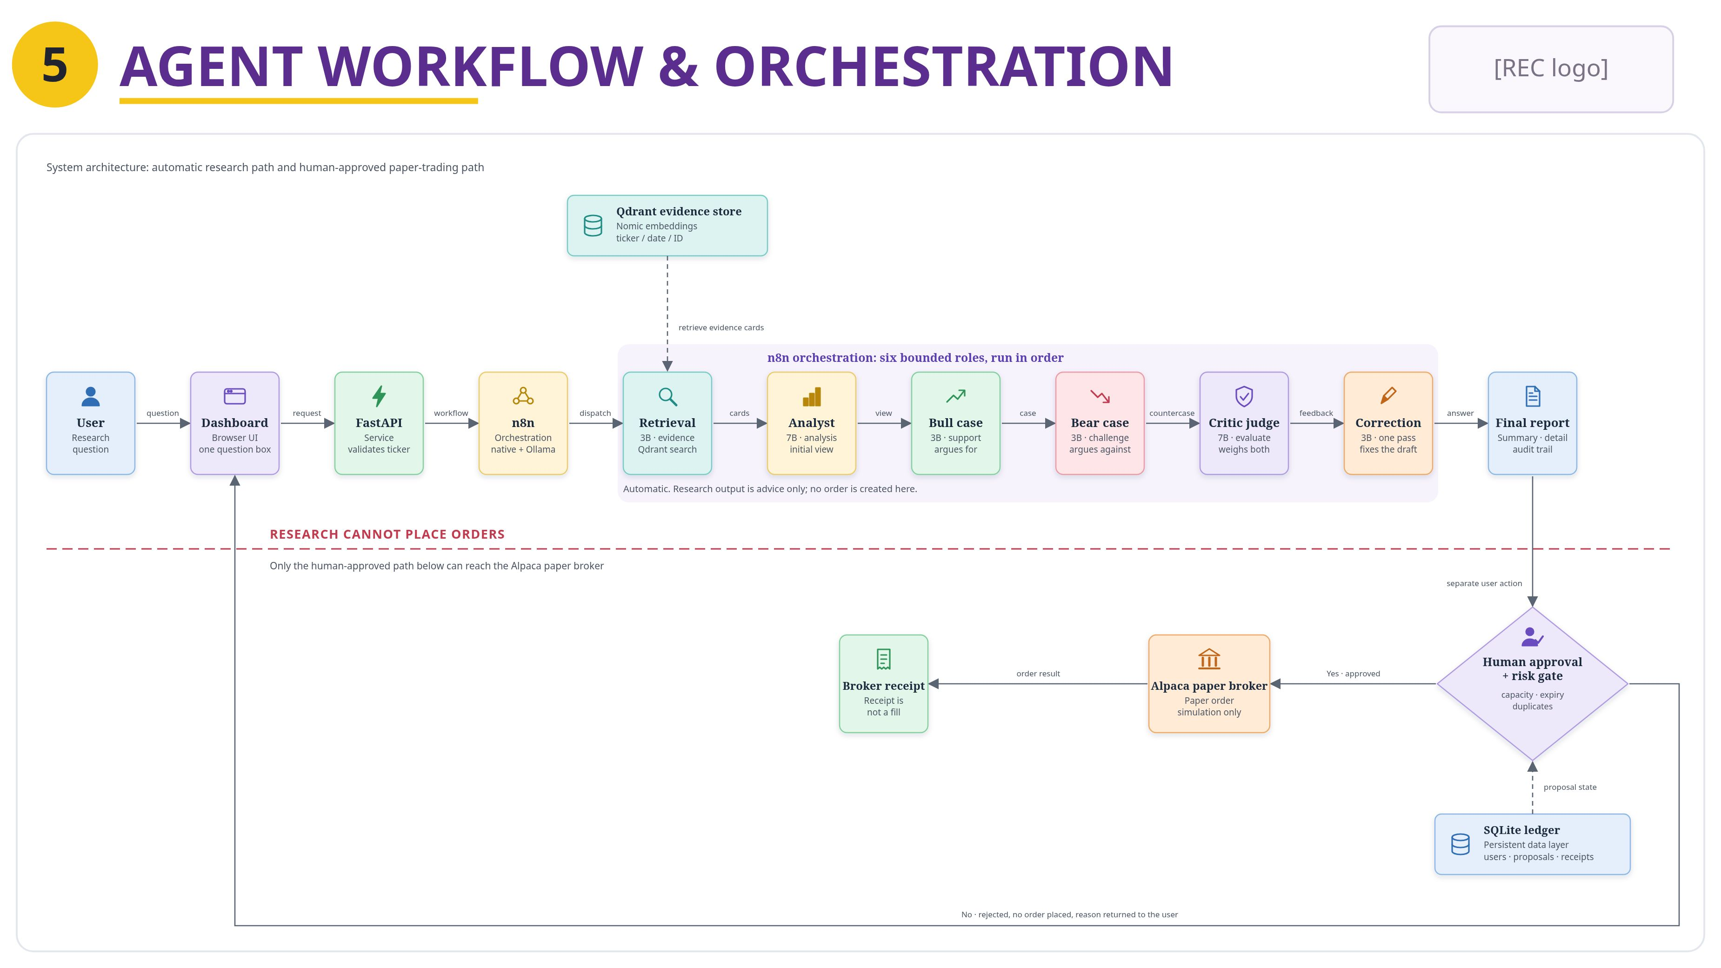
8
AGENT WORKFLOW AND ORCHESTRATION
Final review
Department of Artificial Intelligence and Machine Learning

Slide 7
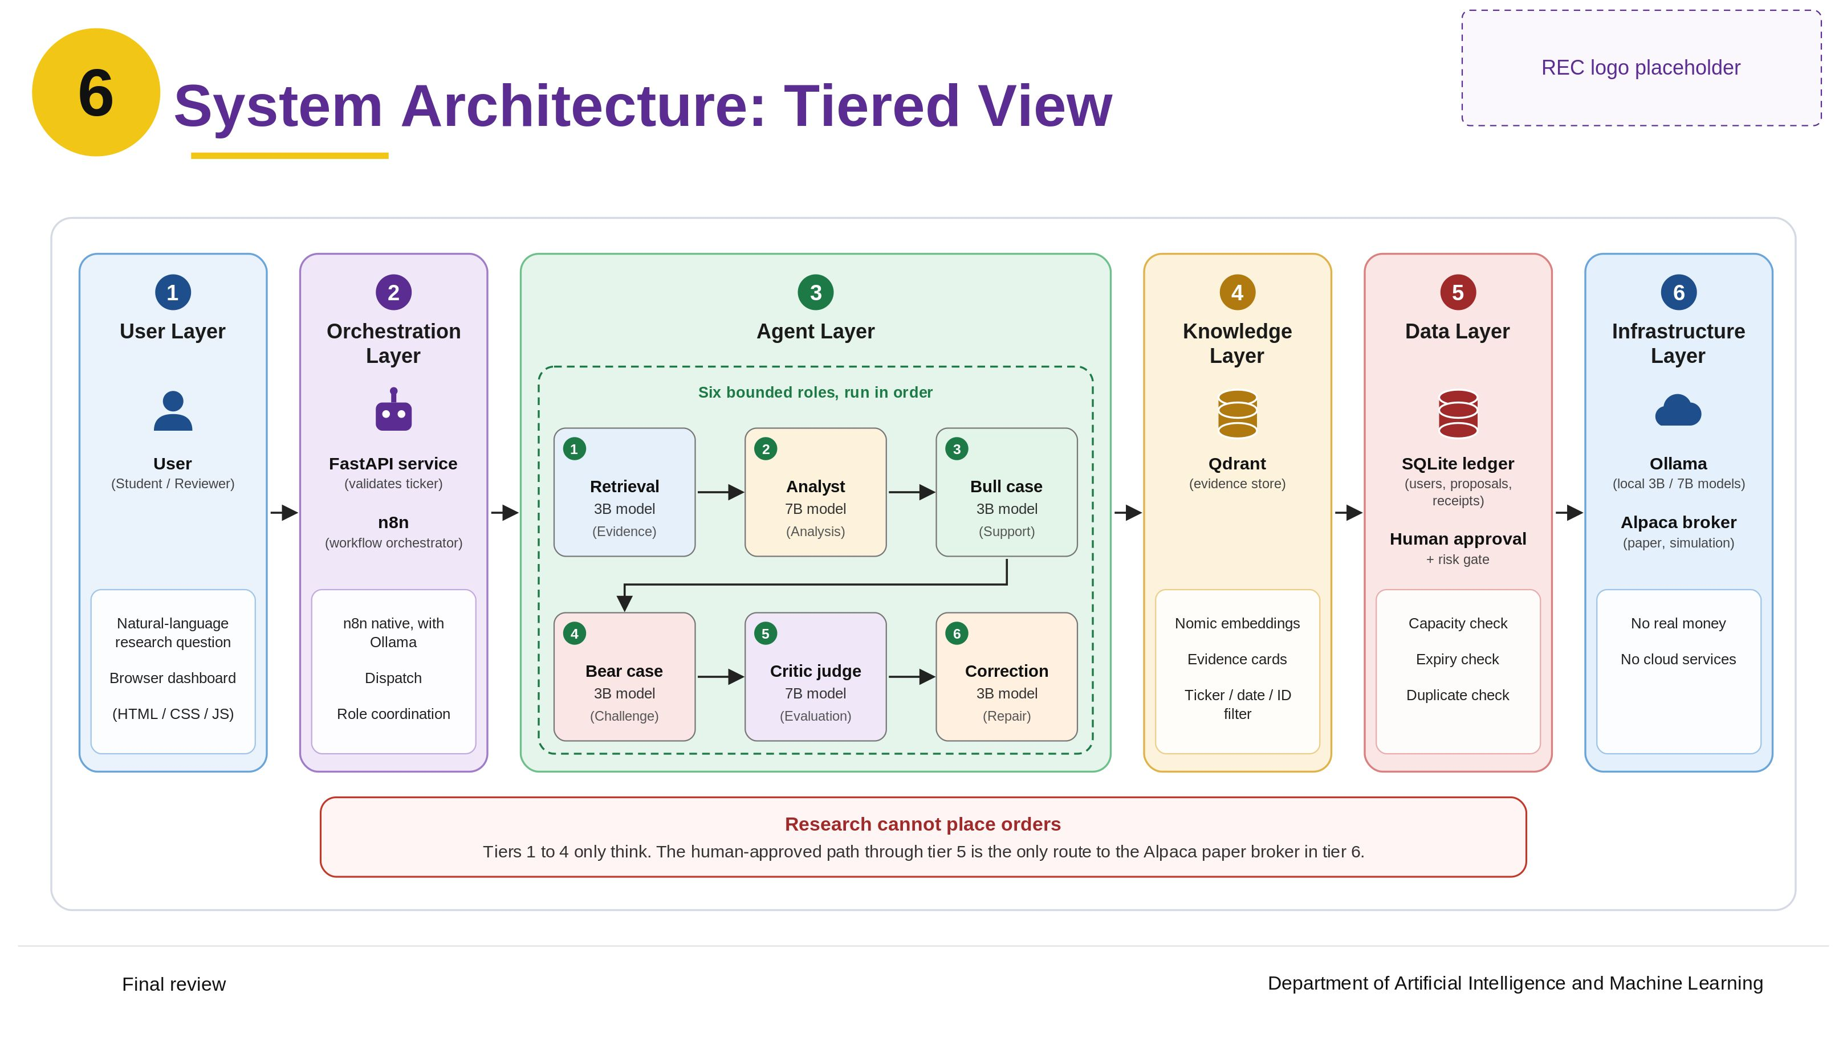
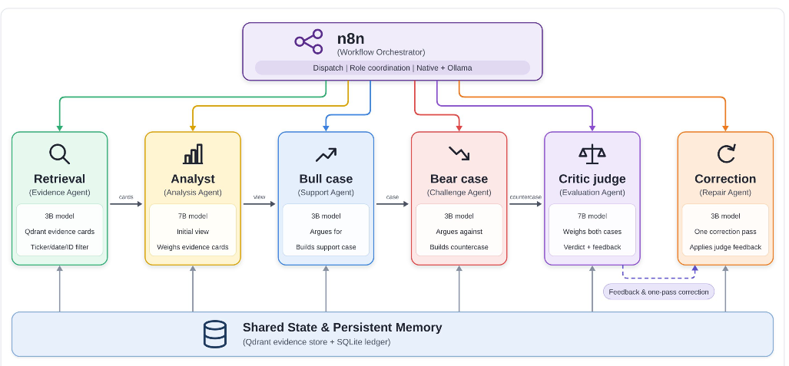
6
AGENTS ARCHITECTURE
Final review
Department of Artificial Intelligence and Machine Learning

Slide 8
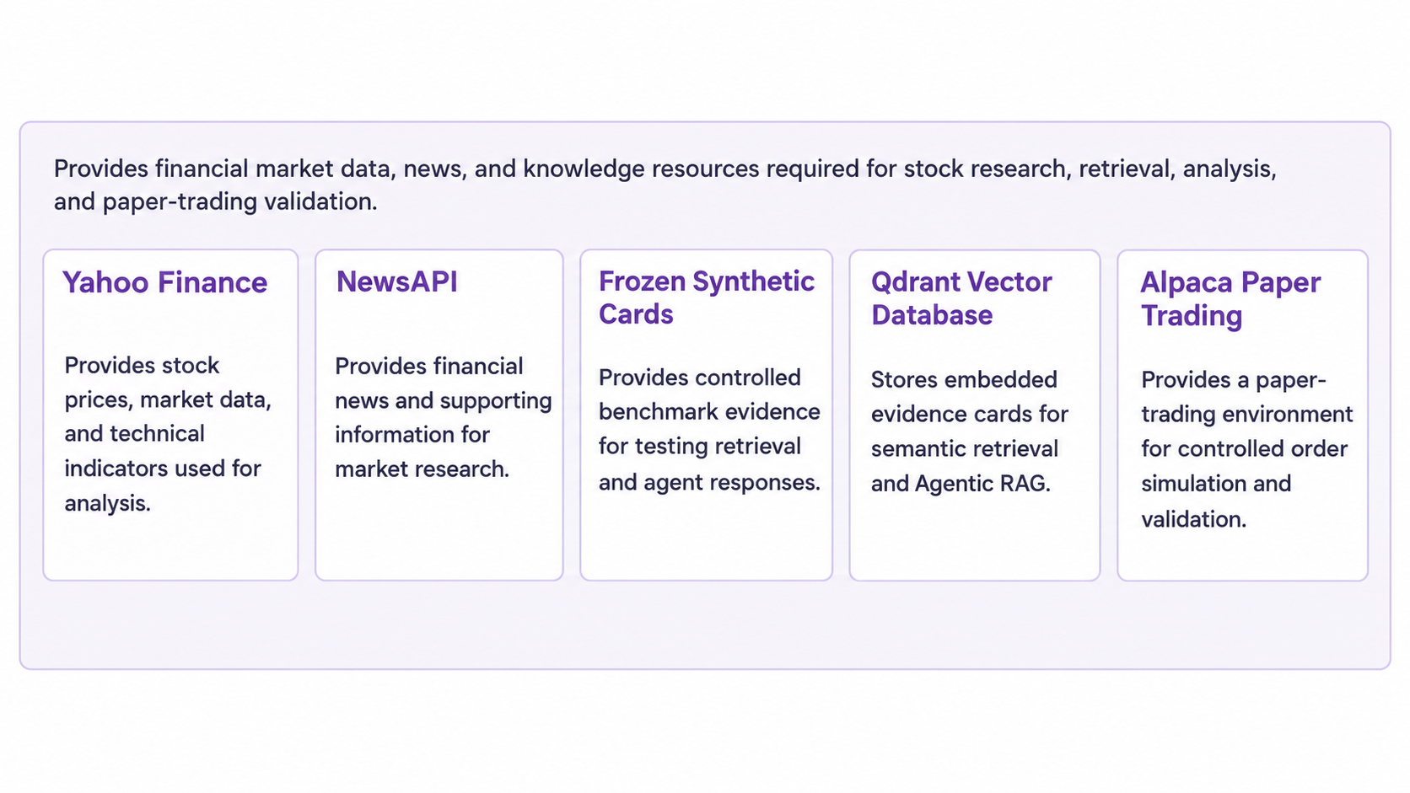
7
Proposed System: Data Sources

Slide 9
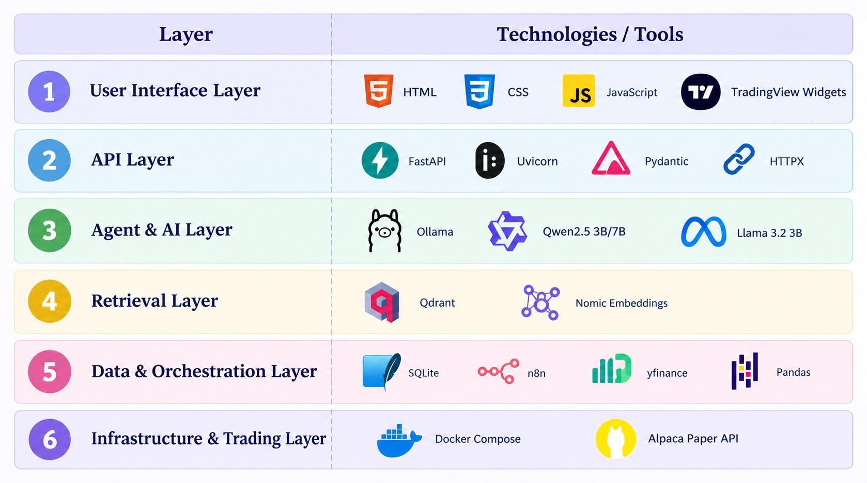
TOOLS AND TECHNOLOGIES USED
8

Slide 10
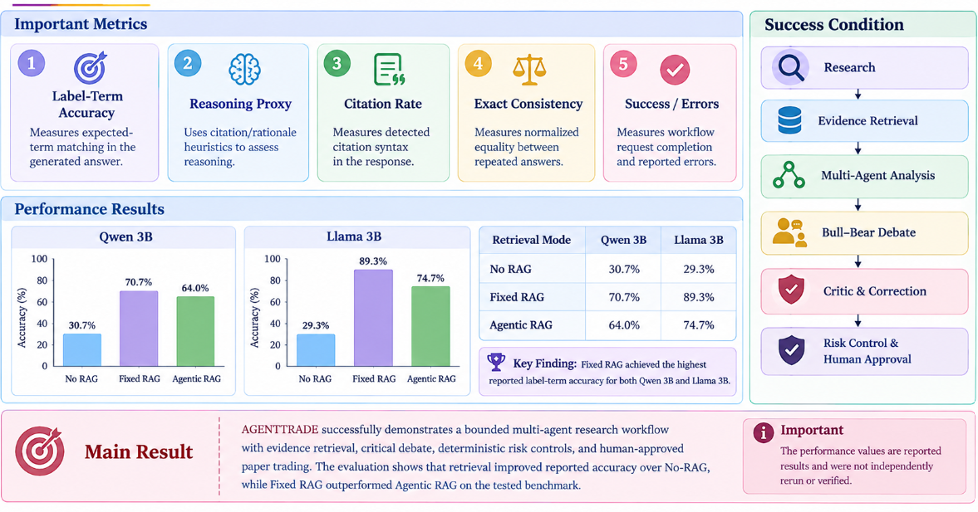
Performance & Success Metrics
Final review
Department of Artificial Intelligence and Machine Learning

Slide 11
Scalability & Real-World
Real-World Applicability
Scalability
Financial Research – Supports structured stock research.
Paper Trading – Enables human-in-the-loop trading simulation.
Expert Review – Requires verified sources and expert validation.
Controlled Deployment – Real trading requires stronger security and operational controls.
More Users – Can be extended for wider user access.
More Data Sources – Can integrate additional financial data sources.
Better Infrastructure – Requires queues, authorization, and monitoring.
Higher Workload – More candidates increase inference and data costs.
Final review
Department of Artificial Intelligence and Machine Learning

Slide 12
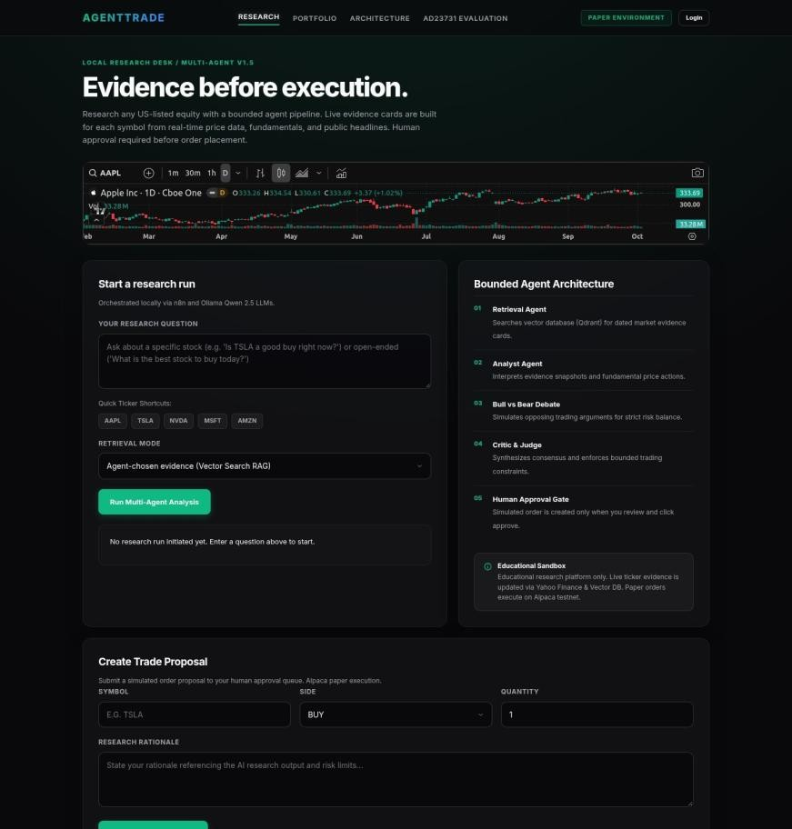
Result
Final review
Department of Artificial Intelligence and Machine Learning

Slide 13
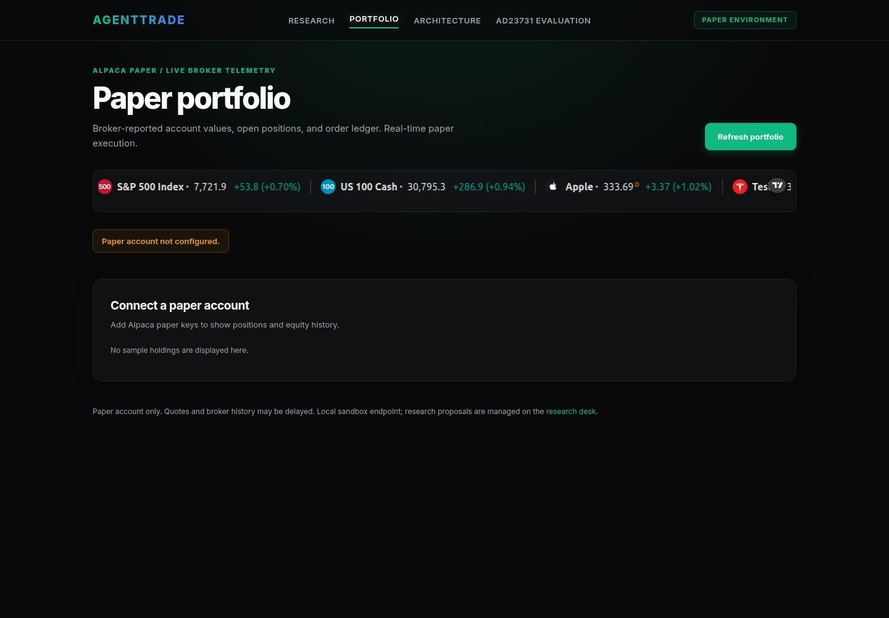
Result
Final review
Department of Artificial Intelligence and Machine Learning

Slide 14
CONCLUSION
AGENTTRADE provides a bounded multi-agent framework for stock research and paper trading.
Evidence Retrieval improves the quality of stock analysis compared with No-RAG.
Bull–Bear Debate and Critic Agents provide multiple perspectives and improve transparency.
Risk Controls and Human Approval keep paper-trading actions controlled and separate from research.
The prototype demonstrates the potential of multi-agent AI for structured and risk-aware financial research

Slide 15

Thank You
Department of Artificial Intelligence and Machine Learning

